Slide 1
Security Hardening – Windows Server 2012R2
Windows Server 2012 – R2
DISA, Release 8
28 April 2017
Domain Controller

Slide 2
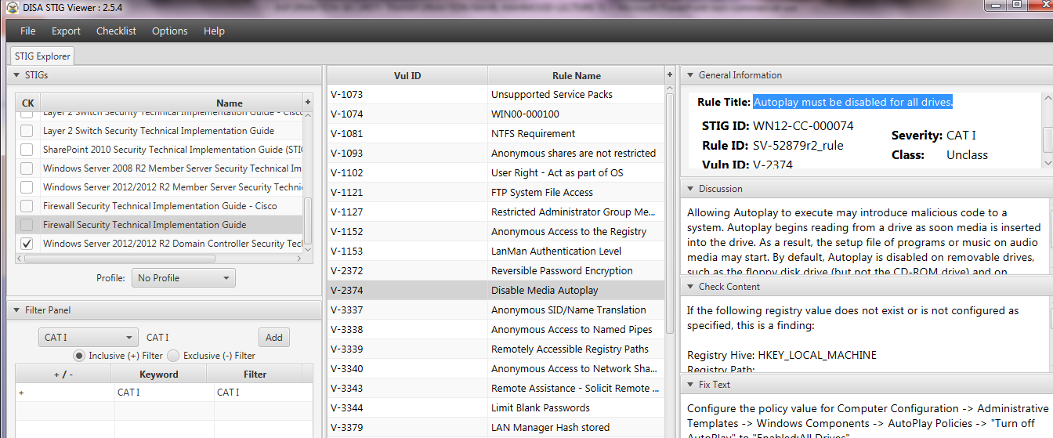
Security Hardening – Windows Server 2012R2
STIGVIEWER WINDOW

Slide 3
Security Hardening – Windows Server 2012R2
General Information:
Rule Title: Autoplay must be disabled for all drives
STIG ID: WN12-CC-000074
Severity: CAT I

Slide 4
Security Hardening – Windows Server 2012R2
Discussion:
Allowing Autoplay to execute may introduce malicious code to a system. Autoplay begins reading from a drive as soon media is inserted into the drive. As a result, the setup file of programs or ….

Slide 5
Security Hardening – Windows Server 2012R2
Discussion…:
music on audio media may start. By default, Autoplay is disabled on removable drives, such as the floppy disk drive (but not the CD-ROM drive) and on network drives.

Slide 6
Security Hardening – Windows Server 2012R2
Discussion…:
Enabling this policy disables Autoplay on all drives.…

Slide 7
Security Hardening – Windows Server 2012R2
Check Content:
If the following registry value does not exist or is not configured as specified, this is a finding:
Registry Hive: HKEY_LOCAL_MACHINE

Slide 8
Security Hardening – Windows Server 2012R2
Check Content:
Registry Path: \SOFTWARE\Microsoft\Windows\CurrentVersion\policies\Explorer\
Value Name: NoDriveTypeAutoRun
Type: REG_DWORD Value: 0x000000ff (255)

Slide 9
Security Hardening – Windows Server 2012R2
Fix Text:
Configure the policy value for Computer Configuration -> Administrative Templates -> Windows Components -> AutoPlay Policies -> "Turn off AutoPlay" to "Enabled:All Drives".

Slide 10
Security Hardening – Windows Server 2012R2
CCI (Control Correlation Identifier):
CCI: CCI-001764 The information system prevents program execution in accordance with organization-defined policies regarding software program usage and restrictions…

Slide 11
Security Hardening – Windows Server 2012R2
CCI (Control Correlation Identifier):
…and/or rules authorizing the terms and conditions of software program usage. NIST SP 800-53 Revision 4 :: CM-7 (2)
END

